Slide 1
Chapter 20

Slide 2
Objectives

Slide 3
Objectives (cont.)

Slide 4
Windows-based authentication

Slide 5
Individual user account authentication

Slide 6
Third-party authentication services

Slide 7
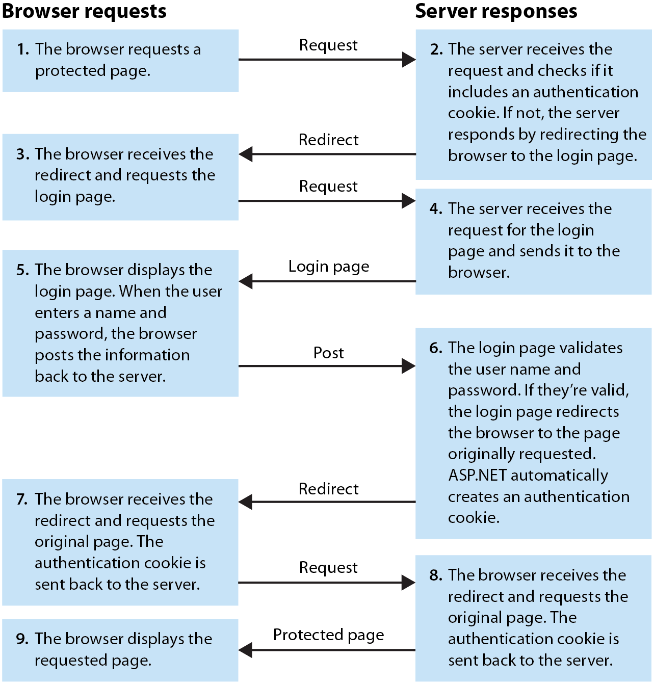
How individual user account authentication works

Slide 8
The main objects used by ASP.NET Identity

Slide 9
Benefits of the new ASP.NET Identity system

Slide 10
How to get the OwinContext object for the current request

Slide 11
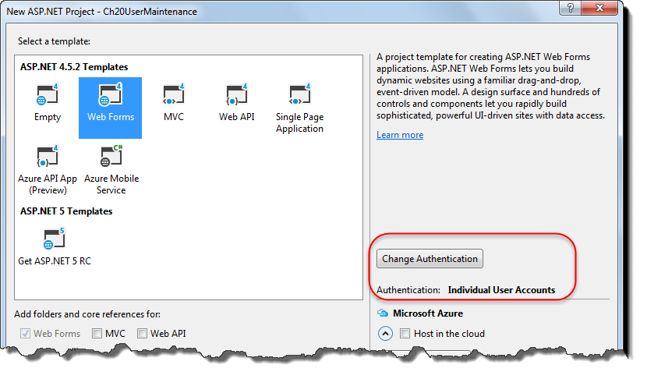
The Web Forms template with Individual User Accounts authentication

Slide 12
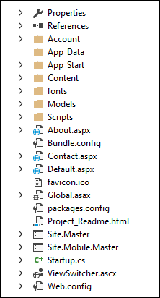
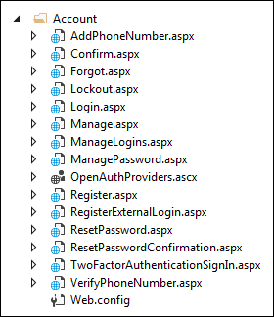
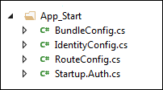

Files and folders of the root, Account, App_Start, and Models directories

Slide 13
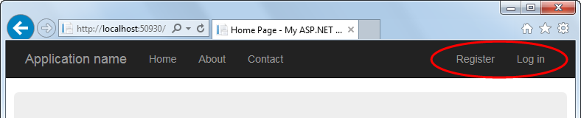
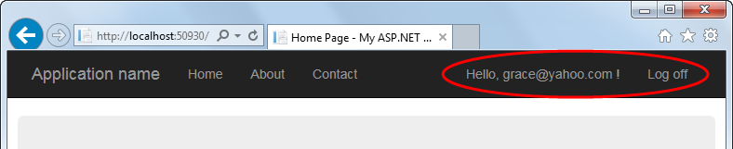
The anonymous and logged in templates of the LoginView control

Slide 14
Some of the aspx code for the navbar in the master page

Slide 15
Some of the aspx code for the navbar in the master page (cont.)

Slide 16
The code for the LoggingOut event of the LoginStatus control

Slide 17
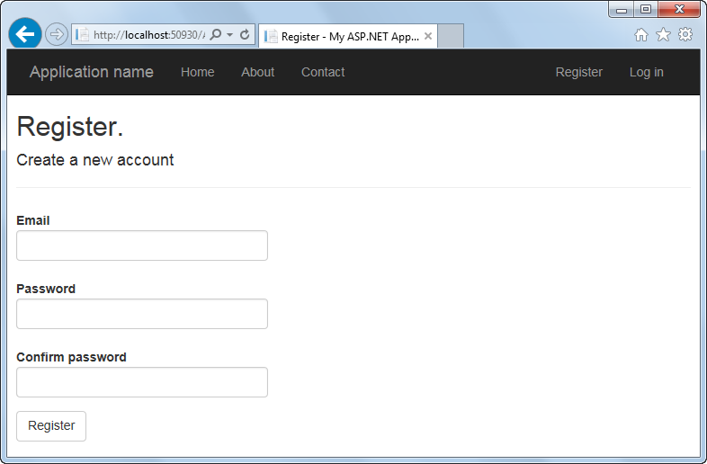
The Register.aspx page of the Web Forms template

Slide 18
The code for the Click event of the Register button

Slide 19
The code for the Click event of the Register button (cont.)

Slide 20
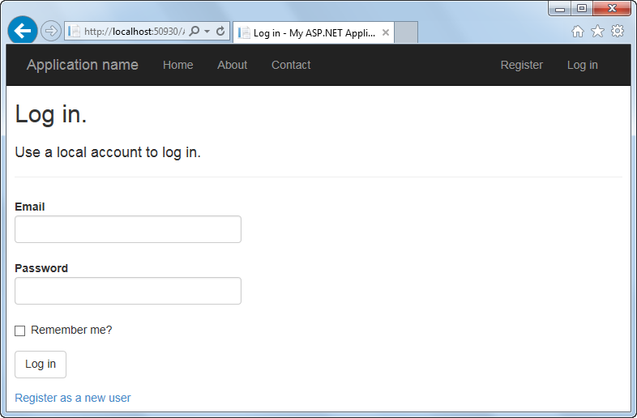
The Login.aspx page of the Web Forms Template

Slide 21
The code for the Click event of the Log In button

Slide 22
The code for the Click event of the Log In button (cont.)

Slide 23
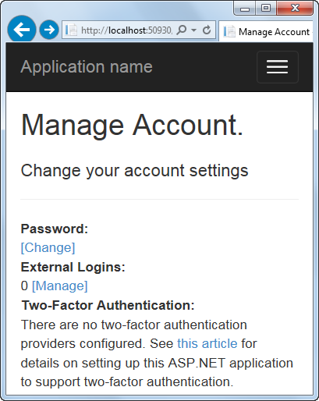
The Manage.aspx page of the Web Forms template

Slide 24
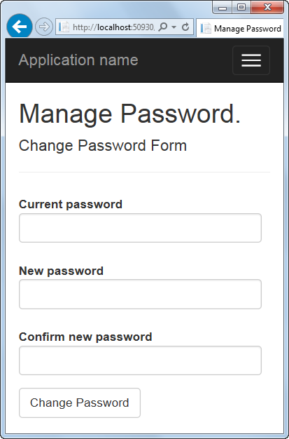
The ManagePassword.aspx page of the Web Forms template

Slide 25
The code for the Click event of the Change Password button

Slide 26
The Create method in the IdentityConfig.cs file

Slide 27
The Create method (cont.)

Slide 28
The Create method (cont.)

Slide 29
Wildcard specifications in the users attribute

Slide 30
An access rule that allows access to all users

Slide 31
Two ways to allow only authenticated users access to the resources in a specific directory

Slide 32
How to allow users in a specific role access to a specific page

Slide 33
Some of the code in the ConfigAuth method

Slide 34
The ApplicationRoleManager class

Slide 35
Code that gets the ApplicationRoleManager object

Slide 36
A property of the RoleManager class

Slide 37
A property of the UserManager class

Slide 38
Two properties of the IdentityResult class

Slide 39
Code that creates a new role

Slide 40
Code that creates a new user

Slide 41
Code that associates the new user with the new role

Slide 42
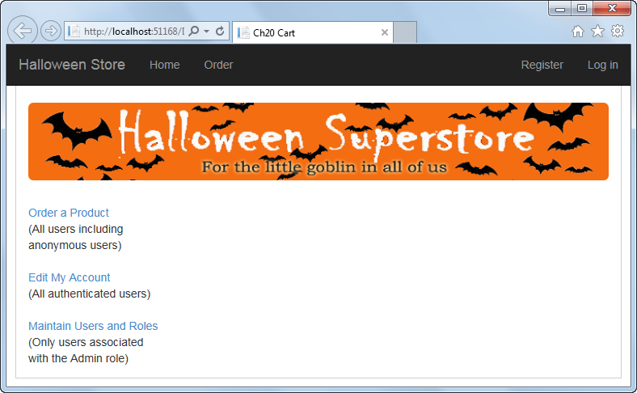
The Home page of the User Maintenance application

Slide 43
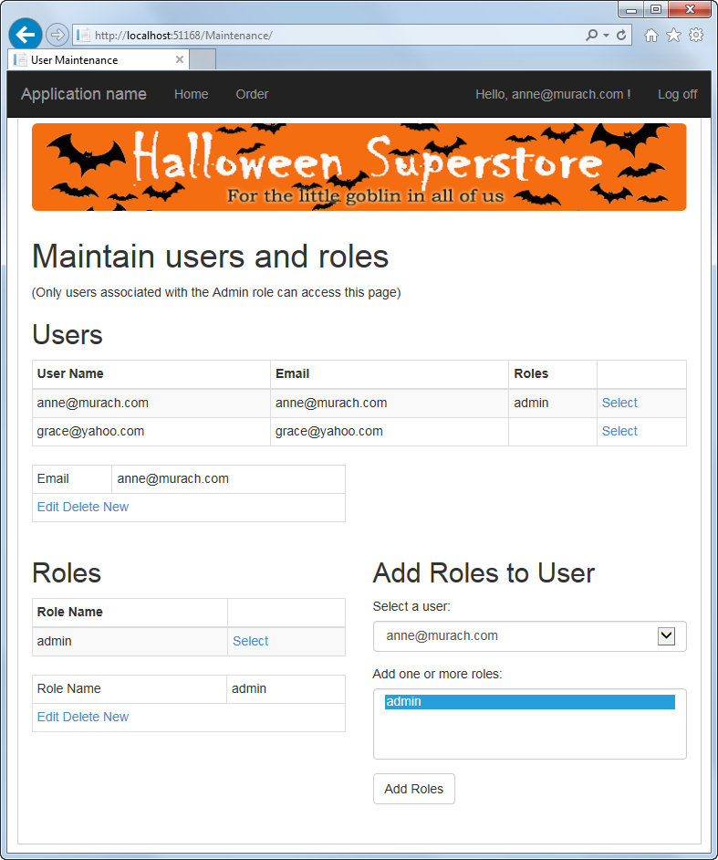
The Maintenance page of the User Maintenance application

Slide 44
The Web.config files for the application

Slide 45
The Web.config files for the application (cont.)

Slide 46
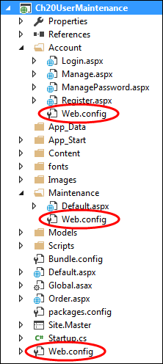
The Web.config files in the Solution Explorer

Slide 47
The GridView control with users and their roles

Slide 48
The connection string for the User Maintenance application

Slide 49
The C# code file for the Maintenance page

Slide 50
The C# code file for the Maintenance page (cont.)

Slide 51
The C# code file for the Maintenance page (cont.)

Slide 52
The C# code file for the Maintenance page (cont.)

Slide 53
The C# code file for the Maintenance page (cont.)

Slide 54
The Package Manager Console (PMC)

Slide 55
Some of the Code First migration commands

Slide 56
How to add a custom BirthDate property to the user data

Slide 57
The new property in the ApplicationUser class

Slide 58
Some of the code in the Up and Down methods of the InitialCreate class

Slide 59
Some of the code in the Up and Down methods of the InitialCreate class (cont.)

Slide 60
The Up and Down methods of the BirthDate class

Slide 61
How to roll the database back to its initial state

Slide 62
The Seed method with the starter code generated by Visual Studio

Slide 63
A Seed method that adds an admin user

Slide 64
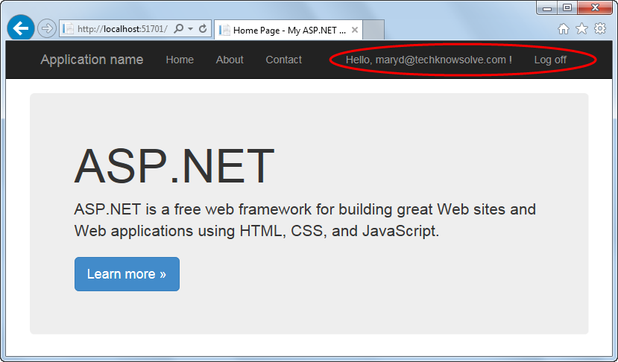
Extra 20-1 Use the default authentication of the Web Forms template

Slide 65
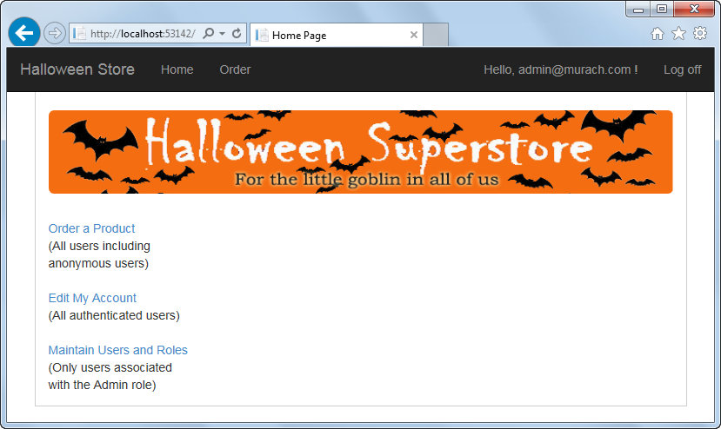
Extra 20-2 Work with users and roles in the User Maintenance application

